Slide 1
STAT 504 – Network and Text Analytics Lecture 13: Clustering
By Dr. Ellie Small

Slide 2
Overview
Topics:
Review
Clustering
Clustering: Example
Clustering in R
Problem

Slide 3
Review
Highlights of Lecture 12
Principal phrases are phrases that are meaningful and common by itself, rather than as part of another phrase. We may obtain principal phrases for the documents in a corpus using the function phraseDoc in the phm package. This will create a phraseDoc object; use the function as.matrix on a phraseDoc object to create a term-document matrix with principal phrases. See ?phraseDoc for its arguments.
The function freqPhrases in the phm package takes a phraseDoc object and a number n as input (default 10) and shows the n most frequent phrases in the corpus.
The function getDocs in the phm package takes a phraseDoc object and a character vector with principal phrases as input and returns a term-document matrix with those principal phrases (if they exist) on the rows and the documents they appear in on the columns.
The function removePhrases in the phm package takes a phraseDoc object and a character vector with principal phrases as input and returns the phraseDoc object with those principal phrases removed.
We can use the term-document matrix with principal phrases just like the term-document matrix with words; for example, we can sum the frequencies by row then use either word cloud on those sums.
Homework 12 Review

Slide 4
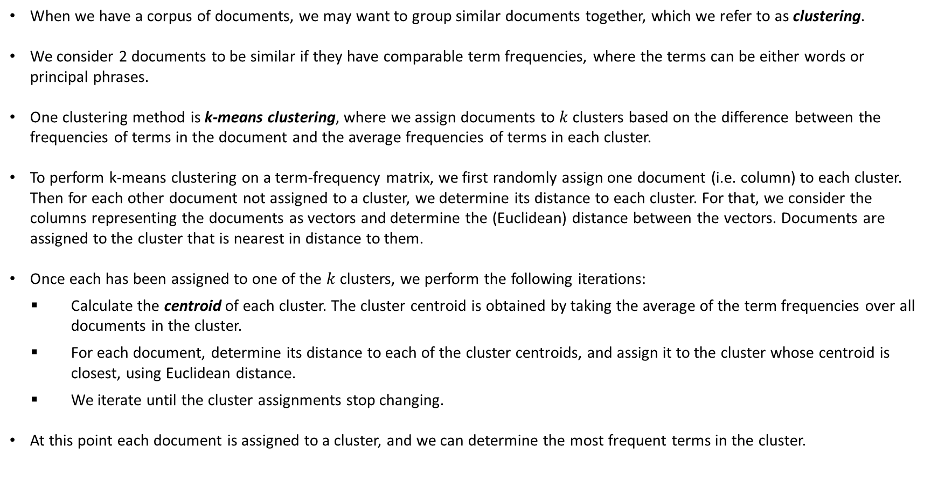
Clustering
When we have a corpus of documents, we may want to group similar documents together, which we refer to as clustering.
We consider 2 documents to be similar if they have comparable term frequencies, where the terms can be either words or principal phrases.
One clustering method is k-means clustering, where we assign documents to $k$ clusters based on the difference between the frequencies of terms in the document and the average frequencies of terms in each cluster.
To perform k-means clustering on a term-frequency matrix, we first randomly assign one document (i.e. column) to each cluster. Then for each other document not assigned to a cluster, we determine its distance to each cluster. For that, we consider the columns representing the documents as vectors and determine the (Euclidean) distance between the vectors. Documents are assigned to the cluster that is nearest in distance to them.
Once each has been assigned to one of the $k$ clusters, we perform the following iterations:
Calculate the centroid of each cluster. The cluster centroid is obtained by taking the average of the term frequencies over all documents in the cluster.
For each document, determine its distance to each of the cluster centroids, and assign it to the cluster whose centroid is closest, using Euclidean distance.
We iterate until the cluster assignments stop changing.
At this point each document is assigned to a cluster, and we can determine the most frequent terms in the cluster.

Slide 5
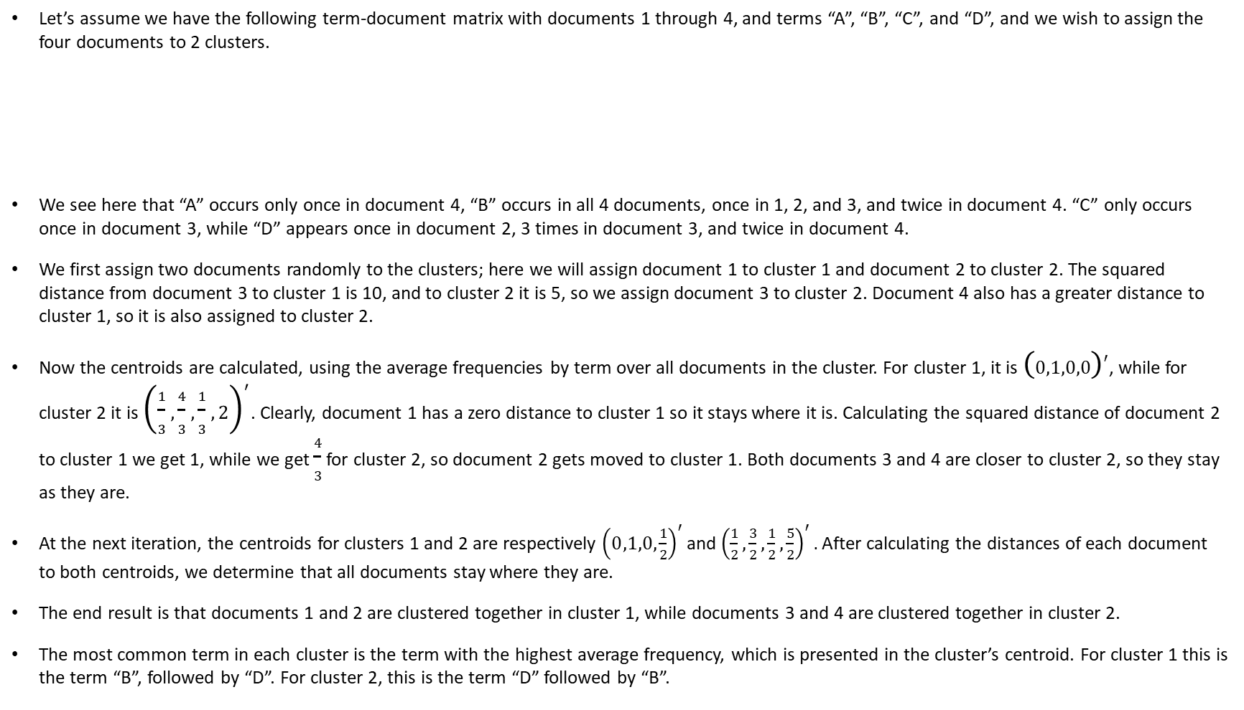
Clustering: Example
Let’s assume we have the following term-document matrix with documents 1 through 4, and terms “A”, “B”, “C”, and “D”, and we wish to assign the four documents to 2 clusters.
We see here that “A” occurs only once in document 4, “B” occurs in all 4 documents, once in 1, 2, and 3, and twice in document 4. “C” only occurs once in document 3, while “D” appears once in document 2, 3 times in document 3, and twice in document 4.
We first assign two documents randomly to the clusters; here we will assign document 1 to cluster 1 and document 2 to cluster 2. The squared distance from document 3 to cluster 1 is 10, and to cluster 2 it is 5, so we assign document 3 to cluster 2. Document 4 also has a greater distance to cluster 1, so it is also assigned to cluster 2.
Now the centroids are calculated, using the average frequencies by term over all documents in the cluster. For cluster 1, it is ${\left(0,1,0,0\right)}^{′}$, while for cluster 2 it is ${\left(\frac{1}{3},\frac{4}{3},\frac{1}{3},2\right)}^{′}$. Clearly, document 1 has a zero distance to cluster 1 so it stays where it is. Calculating the squared distance of document 2 to cluster 1 we get 1, while we get $\frac{4}{3}$ for cluster 2, so document 2 gets moved to cluster 1. Both documents 3 and 4 are closer to cluster 2, so they stay as they are.
At the next iteration, the centroids for clusters 1 and 2 are respectively ${\left(0,1,0,\frac{1}{2}\right)}^{′}$ and ${\left(\frac{1}{2},\frac{3}{2},\frac{1}{2},\frac{5}{2}\right)}^{′}.$ After calculating the distances of each document to both centroids, we determine that all documents stay where they are.
The end result is that documents 1 and 2 are clustered together in cluster 1, while documents 3 and 4 are clustered together in cluster 2.
The most common term in each cluster is the term with the highest average frequency, which is presented in the cluster’s centroid. For cluster 1 this is the term “B”, followed by “D”. For cluster 2, this is the term “D” followed by “B”.
 | 1 | 2 | 3 | 4
A | 0 | 0 | 0 | 1
B | 1 | 1 | 1 | 2
C | 0 | 0 | 1 | 0
D | 0 | 1 | 3 | 2

Slide 6
Clustering in R
We perform k-means clustering in R via the function kmeans, which will cluster the rows of a matrix. In order to cluster the term document matrix, we must have terms on the columns and documents on the rows, so we have to use the transpose of the term document matrix. Also, since the k-means process has a random element (choosing the first clusters), we should set a seed so we can reproduce our results:
m=matrix(c(0,1,0,0,0,1,0,1,0,1,1,3,1,2,0,2),4)
colnames(m)=1:4;rownames(m)=c("A","B","C","D")
m
set.seed(1)
k=2 #Number of clusters
km = kmeans(t(m), k)
The kmeans object, which here we have called km, has (among others) the following attributes:
cluster – a vector with an entry for each document, stating which cluster it is in.
centers - a matrix with a row for each cluster containing its centroid.
size – a vector with an entry for each cluster containing the number of documents in the cluster.
For our example, we have:
km$cluster
km$centers
#Document indices in cluster 1
which(km$cluster==1)
#Number of documents in cluster 1
km$size[1]
#Most frequent phrases in cluster 1
head(sort(km$centers[1,],decreasing=T))
1 2 3 4
A 0 0 0 1
B 1 1 1 2
C 0 0 1 0
D 0 1 3 2
A B C D
1 0.5 1.5 0.5 2.5
2 0.0 1.0 0.0 0.5
1 2 3 4
2 2 1 1
3 4
3 4
[1] 2
D B A C
2.5 1.5 0.5 0.5

Slide 7
Problem
Create a corpus from the PubMed file Covid19March1.txt and call it co.
Create a phraseDoc object called pd from the corpus co.
Create a term document matrix from pd and call it pdm.
Setting the seed to 123, split the documents in the term document matrix into 6 clusters.
What are the sizes of the clusters?
Find the indices of the documents in cluster 6.
Find all nonzero entries of the centroid for cluster 6.
Create a matrix called cl6 with all the phrases present in documents that are in cluster 6.
Find the 6 most frequent phrases in cluster 6 and their total frequencies over all documents in the cluster.
Find the 6 most frequent phrases in cluster 6 and their average frequencies over all documents in the cluster.
Create a corpus called c6 with all documents in cluster 6, then inspect the first document using this corpus. What is its title?

Slide 8
Today’s Summary
Clustering means grouping items together. In the context of text mining, we group documents together based on similarities in the frequencies of their terms.
The centroid of a cluster is a vector containing the average of the term frequencies over all documents in the cluster.
We use the R function kmeans to cluster a term-document matrix; its first argument is the transpose of the term-document matrix and its second argument is the number of clusters we wish to split the documents into.
The kmeans function creates an R object of type kmeans. This has, among others, the following attributes:
cluster – a vector with an entry for each document, stating which cluster it is in.
centers - a matrix with a row for each cluster containing its centroid.
size – a vector with an entry for each cluster containing the number of documents in the cluster.

